Slide 1

Advanced Data Mining Analytics: Multilevel Marketing on Twitter
Samantha Traversi
MDS 564

Slide 2
Project Description
Multilevel Marketing companies are businesses that offer a good or service to their customers, but the direct sales professionals tend to earn a higher profit off recruiting more direct salespeople than from the target product or service.
Social media platforms have high post content with the aim to market products and services of small businesses, be that of multilevel marketing scams or legitimate businesses.
A filter can be applied to social media of individuals vulnerable to the multilevel marketing tactics to reduce exposure and potentially prevent these individuals from getting scammed by these companies.

Slide 3
Data source
#lularoe
#arbonne
#monat
#herbalife
#scentsy
#avon
#marykay
#nuskin
#youngliving
#primerica
#lipsense
#poshmark
#etsy
#retailmenot
#minted
#rewardstyle
#clinique
#pharmaca
#cerave
#gofundme
#glamglow
#kiehls
Twitter was scraped for hashtags belonging to known Multilevel Marketing companies and known legitimate businesses.
Botster was the tool used to scrape Twitter.

Slide 4
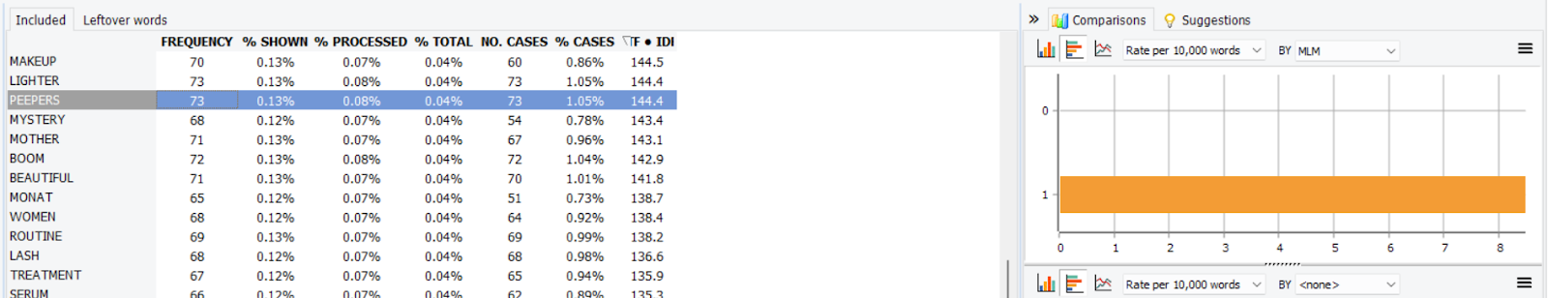
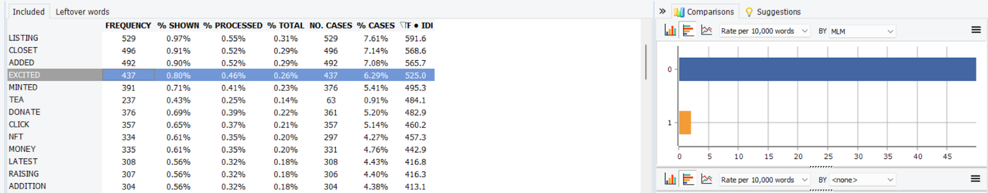
Exploratory Analysis

Slide 5
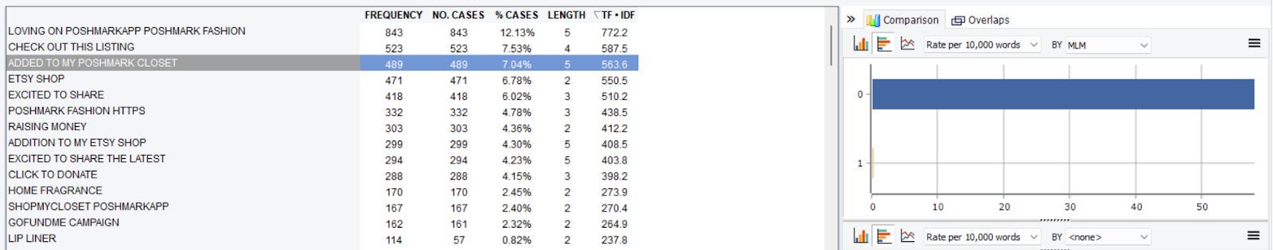
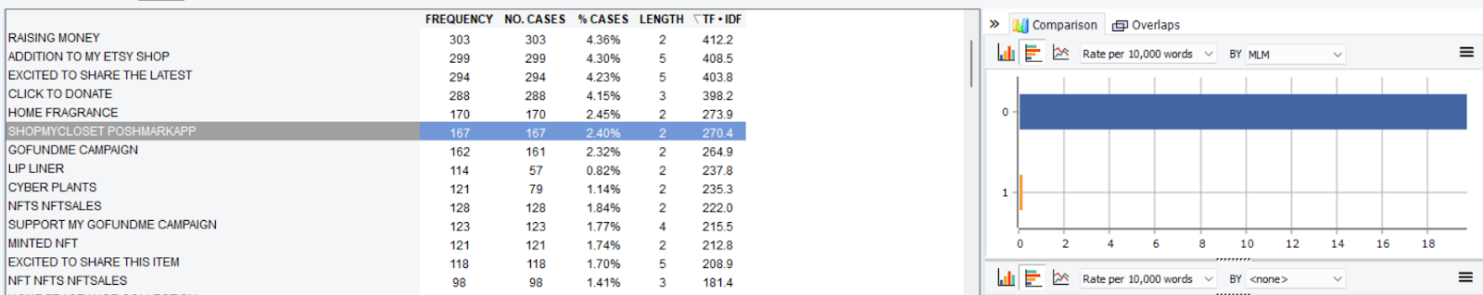
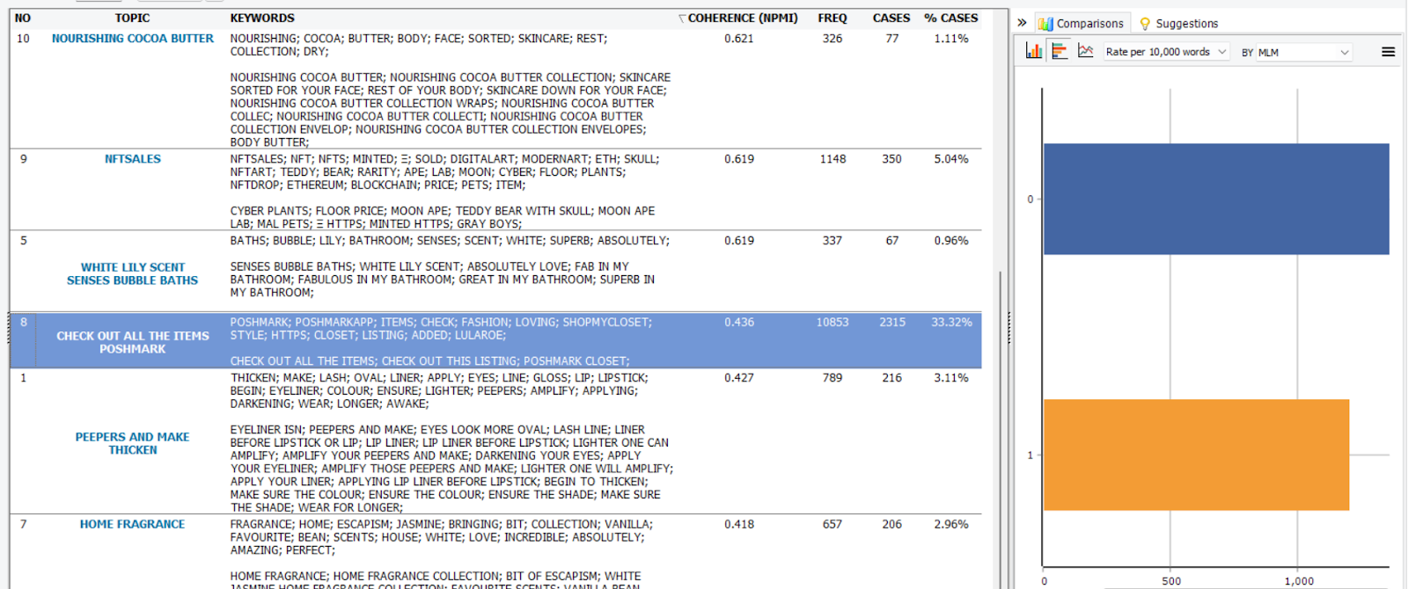
Exploratory Analysis

Slide 6
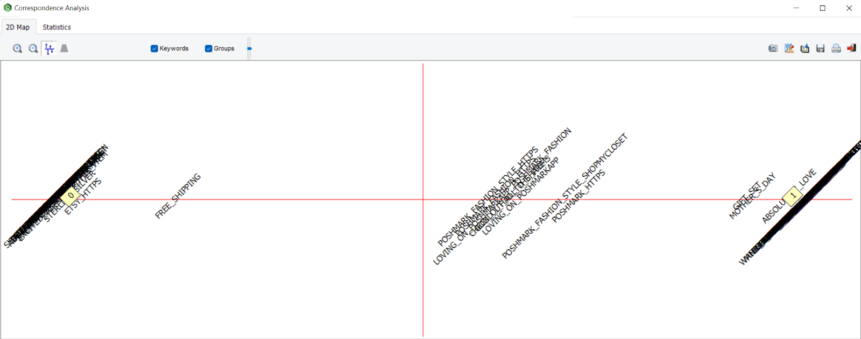
Exploratory Analysis

Slide 7
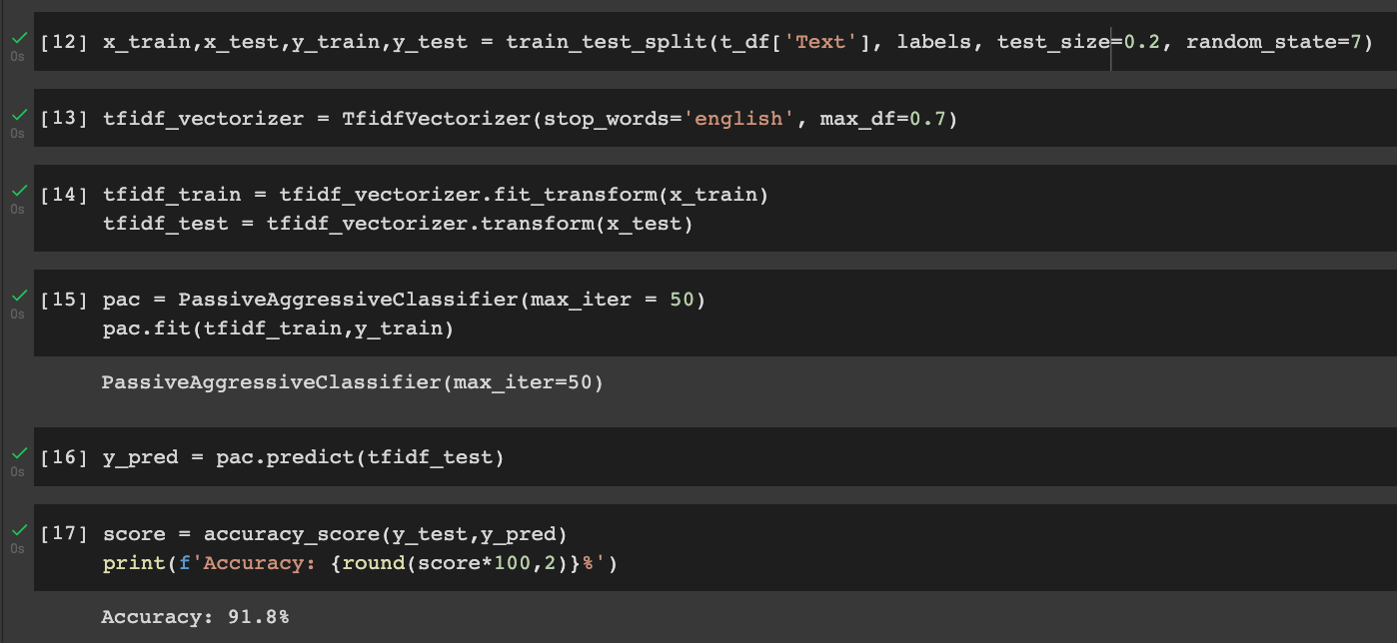
Modeling Results

Slide 8
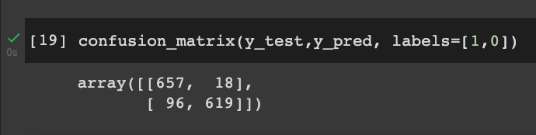
Model Evaluation

Slide 9
Future Recommendations
Analysis performed on posts made on social media platforms other than Twitter
Facebook
Instagram
LinkedIn
More sophisticated text analysis, i.e., dictionary-based sentiment analysis
Analysis performed on social media users to determine whether posting behavior can also be used to predict content about multilevel marketing scams

